Slide 1
HEART DISEASE PREDICTION USING MACHINE LEARNING
BY-
SHUVRA CHAKRABARTY
CSBS 5TH SEM

Slide 2
Introduction
Over the last decade, heart disease or cardiovascular remains the primary basis of death worldwide.
An estimate by the World Health Organization, that over 17.9 million deaths occur every year worldwide because of cardiovascular disease
The vast number of deaths is common amongst low and middle-income countries
Many predisposing factors such as personal and professional habits and genetic predisposition accounts for heart disease.
Medical diagnosis should be proficient, reliable, and aided with computer techniques to reduce the effective cost for diagnostic tests.

Slide 3
Machine learning
Machine learning is an emerging subdivision of artificial intelligence. Its primary focus is to design systems, allow them to learn and make predictions based on the experience. It trains machine learning algorithms using a training dataset to create a model. The model uses the new input data to predict heart disease.

Slide 4
Approach Methodology
This Project aims to foresee the odds of having heart disease as probable cause of computerized prediction of heart disease that is helpful in the medical field .
To accomplish the aim, we have discussed the use of some machine learning algorithms on the data set.

Slide 5
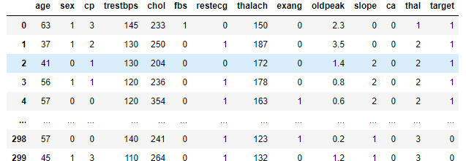
Data Source
For this Project, I have collected the dataset from Kaggle .
It comprises a real dataset of 300 examples of data with 14 various attributes (13 predictors; 1 class) like blood pressure, type of chest pain, electrocardiogram result, etc.

Slide 6
LIBRARIES USE
01
02
03
numpy pandas matplotlib train_test_split StandardScaler
04
05

Slide 7
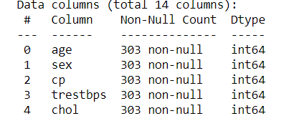
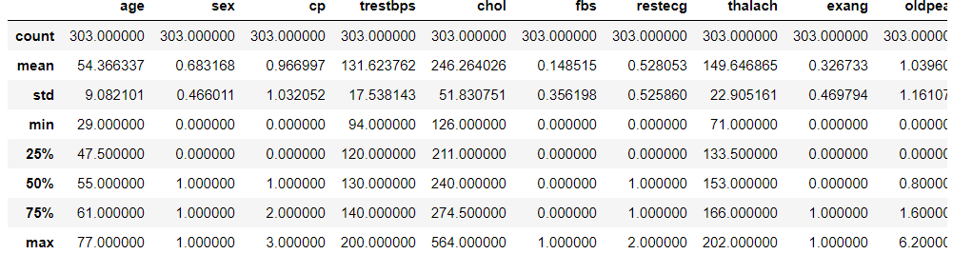
UNDERSTANDING THE DATA
As you can see from the dataset, there are a total of 13 features and 1 target variable. Also, there are no missing values so we don’t need to take care of any null values.
The method revealed that the range of each variable is different. The maximum value of age is 77 but for chol it is 564. Thus, feature scaling must be performed on the dataset.

Slide 8
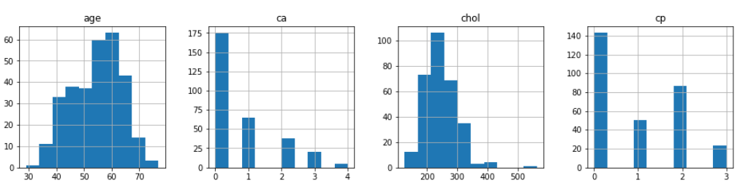
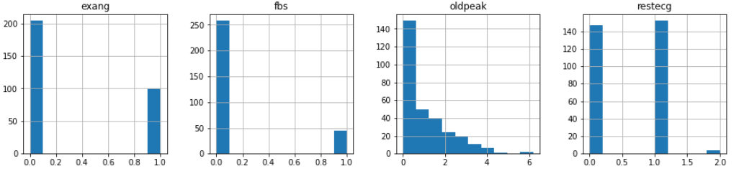
HISTOGRAM
The best part about this type of plot is that it just takes a single command to draw the plots and it provides so much information in return.

Slide 9
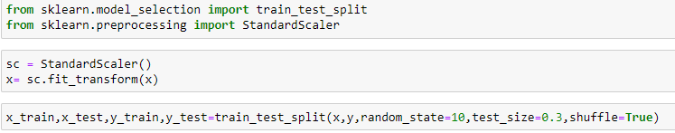
DATA PROCESSING
I split the dataset into 70% training data and 30% testing data.
we need to scale the dataset for which we will use the StandardScaler

Slide 10
ALGORITHMS USED
Decision Tree
Decision tree is a classification algorithm that works on categorical as well as numerical data.
Decision tree is used for creating tree-like structures.
Decision tree is simple and widely used to handle medical dataset.
It is easy to implement and analyze the data in tree-shaped graph. The decision tree model makes analysis based on three nodes.

Slide 11
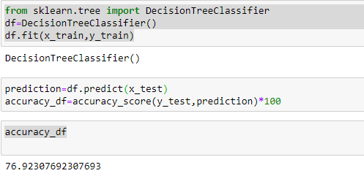
USING DECISION TREE WE GET 76.92% ACCURACY

Slide 12
K-NEAREST NEIGHBORS
The K-nearest neighbors algorithm is a supervised classification algorithm method.
It classifies objects dependent on nearest neighbor.
The calculation of distance of an attribute from its neighbors is measured using Euclidean distance . It uses a group of named points and uses them on how to mark another point. The data are clustered based on similarity amongst them, and is possible to fill the missing values of data using K-NN.
Once the missing values are filled, various prediction techniques apply to the data set. It is possible to gain better accuracy by utilizing various combinations of these algorithms.

Slide 13
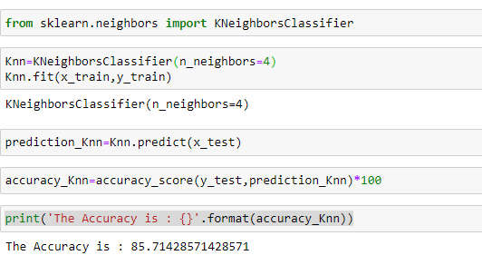
USING KNN WE GET 85.71% ACCURACY
This Project aims to foresee the odds of having heart disease as probable cause of computerized prediction of heart disease that is helpful in the medical field .
To accomplish the aim, we have discussed the use of some machine learning algorithms on the data set.

Slide 14
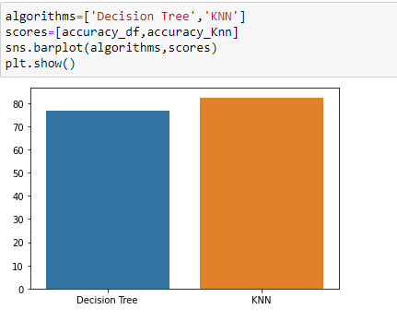
RESULTS AND ANALYSIS
Aim of this Project is to predict whether or not a patient will develop heart disease.
This research was done on supervised machine learning classification techniques using decision tree , K-nearest neighbor.
Dataset was classified and split into a training set and a test set.
The different classification techniques were noted using Python Programming for training and test data sets.
Percentage accuracy scores are for different algorithms.

Slide 15
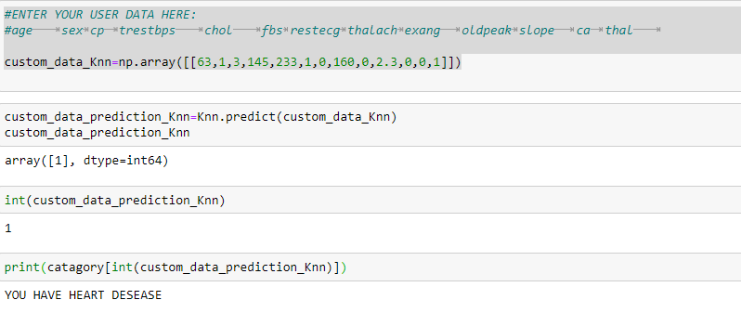
RESULT

Slide 16
CONCLUSION
The project involved analysis of the heart disease patient dataset with proper data processing. Then, 2 models were trained and tested with maximum scores as follows:
K Neighbors Classifier: 85%
Decision Tree Classifier: 76%
K Neighbors Classifier scored the best score of 85% with 4 neighbors.

Slide 17
THANKS!

